Slide 2
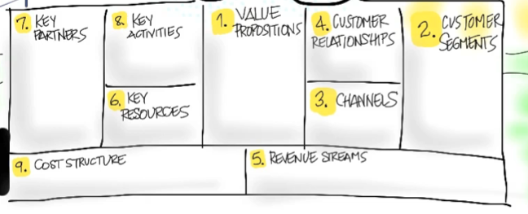
- provide scheduling of appointments with local landscapers
- Offer a rating system for reliable contractors
Our product will be an intangible product, an application to make appointments with local landscaping companies.
The problem we will be solving for our customers is the inconvenience of having to search through common service offering domains such as craigslist.
Our key partners will be landscaping companies and individual landscaping contractors.
-Development will cater to convenience of use
-Unreliable contractors will be tagged.
Customers will consist of individuals who are homeowners, or own a commercial business.
Demographic:
- Homeowners
- Urban/Suburban location
- Commercial business
The assumption is that our customers will use a landscaping company versus doing there own yard-work etc.
-Cost will be heavily dependent on development
-Key activities can possibly change over time
Front and Back end development of the application.
Our revenue will come from both individuals buying our application, and businesses buying the application.
Costs will be in two categories.
1) Research and furthermore Development
2) Analyzing data and maintaining/updating the Software

